Slide 1
Emotion detection from text
DONE BY:
180030326- T. N. S. RAMA CHARAN
180030346-N.NAGA TEJA
180031078-J.BHANU CHAITANYA
SECTION-2

Slide 2
The speech represents a significant role in human communication as we can convey our feelings through it. Emotion is a strong feeling that is derived from one’s circumstance or surroundings. As now a days texting is increased and the manual communication priority has decreased we concentrate mainly on developing a model which analysis if a person is happy or not with the services/product. Text analysis is important to have natural interplay between human beings and machines and also to reduce the alienation and isolation in human beings. In text emotion detection, the emotional state of an individual is extracted from their comments. Our project aims to design a system to detect emotion from text. We will be taking text as an input, which will predict if a person is happy or not

Slide 3
What is text emotion recognization?
Text Emotion Recognition, abbreviated as TER, is the act of attempting to recognize human emotion and affective states from text. This is capitalizing on the fact that certain words reflects underlying emotion through their usage. This is also the phenomenon that.

Slide 4
ABSTRACT
The idea behind creating this project was to build a deep learning model that could detect emotions from the text we have with each other all the time. Nowadays personalization is something that is needed in all the things we experience everyday.
Advances in technology have enabled machines and algorithms to recognize various human emotions. Emotion recognition implies a huge social impact and has become more and more demanding in a variety of fields, from retail to healthcare. Except for the crucial part of emotion recognition in healthcare, which helps in the diagnosis of mental issues, by identification a pattern in emotional types, advertisement is another field, where emotion recognition is thriving. For example many businesses would like to know how customers respond to ads or products. Also, application of emotion recognition can be found in education, where applications can measure real-time learner responses to and engagement with educational content. This way the content of a lecture can be adapted appropriately and the application also serves as mean of measuring the effectiveness of the lecturer.

Slide 5
Therefore, DL has become an important tool for the above mentioned applications, offering great solutions not only to industry but also to social issues. Aiming to contribute to a continously growing field, which provides helpful applications not only in industry, but also in healthcare and society, our team opted for this text emotion recognition project, with promising results.

Slide 6
Dataset
Dataset used is “sentiment-analysis-with-hotel-reviews.csv” dataset which was found on Kaggle.
Dataset link:
https://www.kaggle.com/jonathanoheix/sentiment-analysis-with-hotel-reviews

Slide 7
Emotional states
Happiness
Sadness
Anger
Anticipation
Fear
Loneliness
Jealousy
Disgust

Slide 8
Concepts used:
Python programming language
2. Deep Learning algorithm LSTM.
3. Recurrent Neural Network
Tools used:
Anaconda Navigator
Jupyter note book

Slide 9
RECURRENT NEURAL NETWORK
RNNs are a powerful and robust type of neural network, and belong to the most promising algorithms in use because it is the only one with an internal memory.
Like many other deep learning algorithms, recurrent neural networks are relatively old. They were initially created in the 1980’s, but only in recent years have we seen their true potential. An increase in computational power along with the the massive amounts of data that we now have to work with, and the invention of long short-term memory (LSTM) in the 1990s, has really brought RNNs to the foreground.

Slide 10
Because of their internal memory, RNN’s can remember important things about the input they received, which allows them to be very precise in predicting what’s coming next. This is why they're the preferred algorithm for sequential data like time series, speech, text, financial data, audio, video, weather and much more. Recurrent neural networks can form a much deeper understanding of a sequence and its context compared to other algorithms.

Slide 11
Project Implementation
Importing Libraries
Load the Data
Data Cleaning, Preprocessing the data
Splitting the data into training and testing datasets

Slide 12
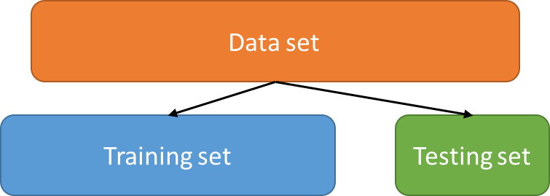
Data Splitting
We split the data into two sets: Training set & Testing set
70% for training and 30% for testing
We train the model using training data

Slide 13
CONCLUSION
Deduction of human emotions through voice and text analysis has a practical plausibility and could potentially be beneficial for improving human conversational and persuasion skills. This project presents an algorithmic approach for detection and analysis of human emotions on the basis of text processing. Two test cases have been examined, corresponding to the two emotional states: happy and not happy. Each case demonstrates characteristic associated grammatical features which can help in distinguishing the corresponding emotional state

Slide 14
